Slide 1
Unit Testing PowerShell with Pester
Boe Prox
@proxb
http://learn-powershell.net

Slide 2



About Me
Microsoft MVP: Cloud and Datacenter Management (PowerShell)
Omaha PowerShell User Group Co-Founder and Co-Leader
12 years in IT
PowerShell Articles
Personal Blog
http://learn-powershell.net
Hey, Scripting Guy!
http://tinyurl.com/HSGBoe
MCP Magazine
http://tinyurl.com/PoshMCPMag
PowerShell Magazine
http://tinyurl.com/PoshMagBP
Powershell.org
http://tinyurl.com/PoshOrgBP
Contributing author for PowerShell Deep Dives
Ch.4: TCP port communications with PowerShell
Ch.26: WSUS and PowerShell

Slide 3
What is Unit Testing?
Checking to see if things should work
TDD and BDD testing
Notes:
TDD: Test Driven Development
BDD: Behavior Driven Development
Not Best Practices; look at PSScriptAnalyzer instead

Slide 4
Why Unit Test PowerShell?
Make sure that your code works the way you think it should
Ensure that bug fixes/feature enhancements do not bring issues in tests that usually pass (regressions)
Simplify integration of code
Make your code more efficient

Slide 5
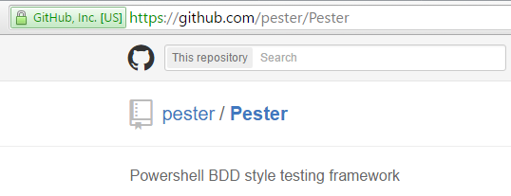
Pester!!
Download from Github
https://github.com/pester/Pester
Comes with Windows 10

Slide 6
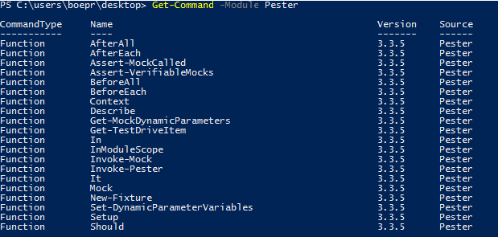
Common Pester Commands

Slide 7
Demo Time!
Creating your first Pester test
Modules
Scripts
Mocking Examples
Code Coverage

Slide 8
Continuous Integration (CI) with Pester
Useful to push to a repo (such as Github)
Automatically runs Pester tests and reports if there are issues
Different approaches
AppVeyor
Team City

Slide 9
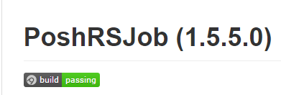
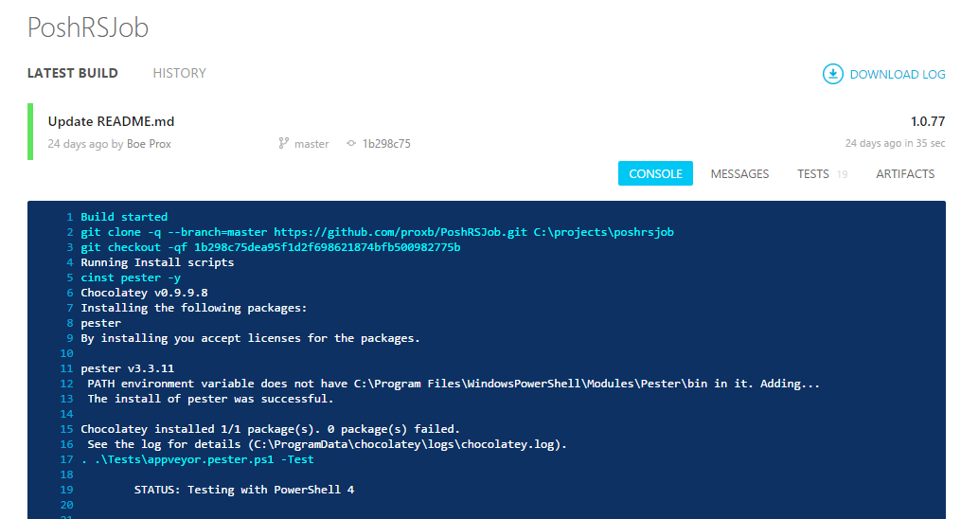

Slide 10
More Than Just Code Tests?!
Operational Validation
Testing the state of the OS or something else but not making changes
BONUS DEMO!
Notes:
Scanning a system or part of a system and then you can output the results to a file if needed.

Slide 11
???????? Questions ????????

Slide 12





Thanks!
http://learn-powershell.net
http://twitter.com/proxb
https://github.com/proxb
http://gplus.to/boeprox
boeprox@gmail.com
Slide deck and example code can be found at:
TODO

